Slide 1
Consumption and footprint analysis of
India associates of
www.cbalance.in
www.bestfootforward.com

Slide 2
Overview of the Hotel
Business hotel
5 Star
Hot & Humid climatic zone
No of rooms = 141
Average room tariff = Rs. 6400
Off-site laundry
Off-site waste water treatment (aerobic)
Year of analysis: 2011-2012
cBalance Solutions Hub

Slide 3
Greenhouse Gas Inventory
*Not including corporate emissions
cBalance Solutions Hub

Slide 4
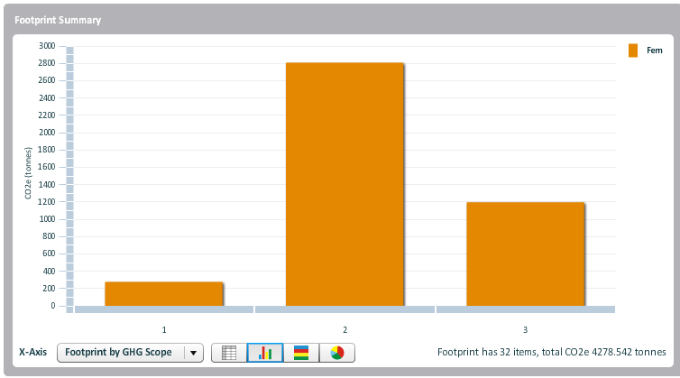
Inventory by Scope & Benchmarks
85%
Total Footprint of hotel 4224.47 tCO2e
Benchmarks
0.12 tCO2e/overnight stay
0.34 tCO2e/square meter
29.9 tCO2e/room/year
9%
6%
cBalance Solutions Hub

Slide 5
Peer based Comparison
In Top 2 percentile for overall energy efficiency
In Top 4 percentile for hotels in Hot & Humid area
In Top 9 percentile for all 5 star hotels
In Top 2 percentile for all business hotels
cBalance Solutions Hub

Slide 6
Results: Based on HCMI Methodology
Total CO2e for reporting period: 1263 tco2e
Total Guestrooms Carbon Footprint 919.34 tCO2e
Total Meetings Carbon Footprint 343.23 tCO2e
Footprint per occupied room on a daily basis 27.2 kgCO2e
Carbon footprint per area of meeting space on an hourly basis 94.0 kgCO2e
cBalance Solutions Hub

Slide 7
Fuel Usage Pattern
cBalance Solutions Hub

Slide 8
Water Inflow Pattern & Usage
Quantity of water | 29069 KL
Associated emissions | 16.1 tCO2e
cBalance Solutions Hub

Slide 9
Waste
Quantity of waste | 112.78 tonnes
Associated emissions | 2.9 tCO2e (composting)
cBalance Solutions Hub

Slide 10
Laundry
Laundry
Quantity of laundry | 639.96 tons
Associated emissions | 163.83 tCO2e
Emissions/ton | 260 kgCO2e/ton
Tent card helped save 2% of laundry
Laundry | Savings
Electricity | 1460 kWh
Water | 480 KL
Furnace Oil | 700 l
GHG emissions | 4.4 tCO2e/year
cBalance Solutions Hub

Slide 11
Solid Waste Management
Material | Quantity/year | Avoided Emissions (tCO2e)
Paper | 8491 kg | 23.8
Plastic | 3202 kg | 5.4
Glass | 9789 kg | 2.1
Metals | 2092 kg | 24.9
Cloth | 322 pieces | Reused as dusters
Total |  | 56.2
cBalance Solutions Hub

Slide 12
Water Related Practices
Rainwater Capture Area=3130.55 sq m.
Campus Area = 1046sq m.
7% of captured rainwater is reused = 360 KL/year
93% of captured rainwater is recharged into the ground = 4782 KL/year
Activity Description | Key Performance Indicators
Rainwater Harvesting(Reuse) | 10% of campus area used
Rainwater Harvesting(Recharge) | 80% of campus area used
Managed Irrigation | 1082 l of water/square meter of garden/year
cBalance Solutions Hub

Slide 13
Energy related Practices
Lighting Equipment Efficiency
Total Lighting Fixtures= 6157
CFL Fixtures= 1457
LED Fixtures= 4191
Energy Saving TFL Lighting= 509
Lighting Equipment Efficiency
Total Lighting Wattage = 35159
CFL Wattage= 7599
LED Wattage= 17588
Energy Saving TFL Wattage= 5712
Activity Description | Key Performance Indicators
CFL Lighting | 24%
LED Lighting | 68%
Energy Saving TFL Lighting | 8%
Activity Description | Key Performance Indicators
CFL Lighting | 22%
LED Lighting | 50%
Energy Saving TFL Lighting | 16%
cBalance Solutions Hub

Slide 14
Energy related Practices
Energy efficient AC’s
Total Tonnage of split AC’s= 16 tonnes
10 Units
HVAC Efficiency
Total Tonnage of HVAC System = 1x125 TR = 375 TR
Activity Description | Key Performance Indicators
% tonnage from 3 star or above rate equipment | 50% of Tonnage
Activity Description | Key Performance Indicators
Thermo Storage | 100% of Tonnage
cBalance Solutions Hub

Slide 15
Energy related Practices
Equipment Energy Efficiency
Total Horse Power Of Pump= 215.5 Total Horse Power of VFD Pumps = 52.5
Activity Description | Key Performance Indicators
VFD Pumps | 24 % of Total Pumping Capacity
F&B Energy Efficiency
Total Refrigeration Volume= 11500 liters Total Meals Served= 320586
Activity Description | Key Performance Indicators
Reduced Refrigeration | 0.036 Liters of Refrigeration/ Meal Served
Architectural Energy Efficiency
Total Natural Light Area= 750.7 square meter
Activity Description | Key Performance Indicators
Natural Lighting | 6 % BUA naturally Lit (daytime)
Solar Heat Gain Control | 100 % Double Glazed (BUA basis)
cBalance Solutions Hub

Slide 16
Energy related Practices
Equipment Energy Efficiency
Total Running length of hot and chilled Water pipes= 1280m
Activity Description | Key Performance Indicators
%(running meter) insulated hot/cold water piping | 100%
Total Area covered by Building Management system= 3603 sq.m
Total Area Covered by Motion Controlled System= 5930 sq.m
Activity Description | Key Performance Indicators
BMS Controlled Area | 29% of BUA
Occupancy Controlled Area | 49% of low traffic BUA area
Power Factor Improvement System | 0.99 Average annual Power Factor
cBalance Solutions Hub

Slide 17
Guest & Local Sustainable Activities
No guest sustainability activities
9 events conducted by staff during the year
Activity Description | Key Performance Indicators
Activities for economic development of local communities | 0 % of revenue
Activities for social development of local communities | <1 % of total man hours
Activities for environmental development of local communities | <1 % of total man hours
cBalance Solutions Hub

Slide 18
Other significant Initiatives
Eco button :
The eco button provided in rooms which increases the temperature of the AC by 2 degrees was pressed 541 times in 6 months or approx. 1080 times in a year
Kitchen
Induction stoves for buffet counters
3 energy efficient self cooking centers from Rational
De-frost freezers and clean fridges weekly to improve efficiency
Peddle push for hand wash
Housekeeping
4 bin method of segregation
All garbage segregated at source
Jute slipper, box etc provided in the rooms
F&B
Neither Straws are being used nor paper napkin
No coasters
Glass bottles provided for water rather than bottled water & Don’t fill the full glass of water unless asked for
Management
Email usage is mandated & Recycled paper is used for all stationary
cBalance Solutions Hub

Slide 19
Additional points Observed
Excellent data collection in the Housekeeping and Engineering departments
All staff members very knowledgeable about sustainability initiatives within their department
cBalance Solutions Hub

Slide 20
Potential room for Improvement
No sustainability initiatives involving guests
% of social development activities is very low
No norms for use of organic food
50% of split AC capacity is 3 star rated and the rest 2 star or lower
cBalance Solutions Hub

